Slide 1
PROBLEM SOLVING AND COMPUTER PROGRAMMING
Lecture 05:
Multidimensional Arrays(2D)

Slide 2
Multidimensional Array
In C++, we can create an array of an array, known as a multidimensional array
For example
  int a[4][3];
Here, a is a two-dimensional array. It can hold a maximum of 12 elements.
Three-dimensional arrays
float x[2][3][4];
This array x can hold a maximum of 24 elements.

Slide 3
What is matrix ?
A matrix is a collection of numbers arranged into a fixed number of rows and columns (2-dimensional matrix). If these rows and columns are arranged into layers then it is called 3-dimensional matrix.

Slide 4
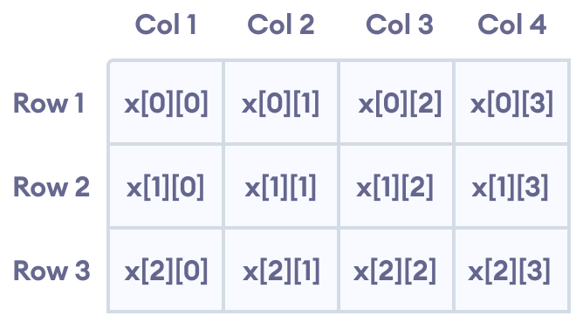
For example int a[4][3];
Here, a is a two-dimensional array. It can hold a maximum of 12 elements.
NITW -- PSCP09

Slide 5
Why do we need matrices?
Consider the following situations:
Store the grades of 60 students each of which is taking 5 courses.
The students grades representation example above can be extended to cover several sections.
In 1, we would either use 60 arrays each of size 5, one for each student or 5 arrays each of size 60, one for each course.
But the limitation of this approach is we need more number of variable. In 1, we need 60 (or 5) different variables to sore the grades of all 60 students.

Slide 6
Matrices
Do we need new data type (or data structure) to represent matrices ?
  No
What is the solution for storing matrices ?
  Array of Arrays
How to declare array of arrays?
  int b[2][3];
  Declares
    The name of the array to be b
    The type of the array elements – array of ints
    b[0], b[1] are each arrays of size 3.
    Informally b is used to represent a 2 dimensional array.
    Actually b is an array of arrays.

Slide 7
Matrices
How to initialize array of arrays?
  Initialized directly in the declaration statement.
    int b[2][3] = {51, 52, 53, 54, 55, 56};
    b[0][0] = 51 b[0][1] = 52 b[0][2] = 53
  Use braces to separate rows in 2-Dimensional matrices.
    int c[4][3] = {{1, 2, 3}, {4, 5, 6}, {7, 8, 9}, {10, 11, 12}};
    int c[ ][3] = {{1, 2, 3}, {4, 5, 6}, {7, 8, 9}, {10, 11, 12}};
  It implicitly declares the number of rows to be 4.

Slide 8
Matrices Representation
Int b[3][4] = {{4,1,0,2}, {-1,2,4,3}, {0, -1, 3, 1}}
Row 0
4 | 1 | 0 | 2
-1 | 2 | 4 | 3
0 | -1 | 3 | 1
Row 1
Row 2
Column 0
Column 1
Column 2
Column 3

Slide 9
Matrices Representation
int a[3][3] = {{12, 13, 14}, {1, 2, 3}, {4, 5, 8}}
Internal representation is flat (not in the form of matrix)
Logically (we feel)
a[0]
a[1]
a[2]
Physically (in memory)
a[0][0] a[0][1] a[0][2] a[1][0] a[1][1] a[1][2] a[2][0] a[2][1] a[2][2]
12 | 13 | 14
1 | 2 | 3
4 | 5 | 8
12 | 13 | 14 | 1 | 2 | 3 | 4 | 5 | 8

Slide 10
How to access individual elements of the Array of Arrays?
int matrix[3][4];
matrix has 12 integer elements
matrix[0][0] element in first row, first column
matrix[2][3] element in last row, last column
matrix is the address of the first element
matrix[1] is the address of the Row 1 column 0

Slide 11
Addition of two matrices
Two matrices are added if the size of the two matrices are same.
The matrix addition will be done by adding the same position element in the first matrix-1 with the same position element in matrix-2.
(A + B)_{ij} = A_{ij} + B_{ij} where 1 ≤ i ≤ m and 1 ≤ j ≤ n
Algorithm –
int a[10][10], b[10][10], c[10][10]
read m, n // size of the matrices
Starting with i from 0 to m-1
  Starting with j from 0 to n-1 Read a[i][j];
Starting with i from 0 to m-1
  Starting with j from 0 to n-1 Read b[i][j];

Slide 12
Addition of two matrices
// add the matrices a and b
Starting with i from 0 to m-1
  Starting with j from o to n-1
    c[i][j] = a[i][j] + b[i][j];
// display the resultant matrix
Starting with i from 0 to m-1
  Starting with j from 0 to n-1
    Output c[i][j];

Slide 13
Program - Addition of two matrices
#include <iostream>
#include<iomanip>
using namespace std;
int main()
{ int m, n, i, j, a[10][10], b[10][10], c[10][10];
// m and n are the size of the matrices, a and b are the input
// matrices and addition a and b are stored in c
cout << "Enter the number of rows and columns of matrix";
cin >> m >> n;
cout << endl << "Enter the elements of first matrix";
for ( i = 0 ; i < m ; i++ )
for ( j = 0 ; j < n ; j++ )
cin >> a[i][j];

Slide 14
Program - Addition of two matrices
cout << endl << "Enter the elements of second matrix";
for ( i = 0 ; i < m ; i++ )
for ( j = 0 ; j < n ; j++ ) cin >> b[i][j];
//add the two matrices
for ( i = 0 ; i < m ; i++ )
for ( j = 0 ; j < n ; j++ ) c[i][j] = a[i][j] + b[i][j];
cout << endl << "Sum of the two matrices are ..." << endl;
for ( i = 0 ; i < m ; i++ )
{
for ( j = 0 ; j < n ; j++ ) cout << " " << c[i][j];
cout << endl;
}
return 0;
}

Slide 15
Transpose of a given matrix
The transpose of a matrix A is another matrix A^{T} created by any one of the following equivalent actions:
  Reflect A over its main diagonal (which runs from top-left to bottom-right) to obtain A^{T}
  Write the rows of A as the columns of A^{T}
  write the columns of A as the rows of A^{T}
Formally, the i th row, j th column element of A^{T} is the j th row, i th column element of A:
If A is an m × n matrix then A^{T} is an n × m matrix

Slide 16
Algorithm – Transpose of a given matrix
Algorithm –
int a[10][10], b[10][10]
read m, n // size of the input matrix
Starting with i from 1 to m
  Starting with i from 1 to n Read a[i][j];
// transpose the matrix a
Starting with i from 1 to m
  Starting with i from 1 to n // is there any error?
    b[j][i] = a[i][j];
// display the resultant matrix
Starting with i from 1 to n // observe no. of rows are n
  Starting with i from 1 to m // observe no. of columns are m
    Output b[i][j];

Slide 17
Program – Transpose of a given matrix
#include <iostream>
#include<iomanip>
using namespace std;
int main()
{ int m, n, i, j, a[10][10], b[10][10];
// m and n are the size of the matrices, a is the input matrix
// Transpose of a is stored in b
cout << "Enter the number of rows and columns of a matrix";
cin >> m >> n;
cout << endl << "Enter the elements of matrix";
for ( i = 0 ; i < m ; i++ )
for ( j = 0 ; j < n ; j++ )
cin >> a[i][j];

Slide 18
Program - Transpose of a given matrix
// Transpose of matrix a
for ( i = 0 ; i < m ; i++ )
for ( j = 0 ; j < n ; j++ ) b[j][i] = a[i][j]; // will this work ?
cout << endl << “ Transpose of the given matrix is ..." << endl;
for ( i = 0 ; i < n ; i++ ) // no. of rows are n
{
for ( j = 0 ; j < m ; j++ ) // no. of columns are m
cout << " " << b[i][j];
cout << endl;
}
return 0;
}

Slide 19
Multiplication of two matrices
The order makes a difference…A * B is different from B * A.
The multiplication is possible if the number of columns in first matrix must equal number of rows in second matrix. In other words, the inner dimensions must be equal.
The resultant matrix size is the number of rows in first matrix by number of columns in second matrix. In other words, the outside dimensions.

Slide 20
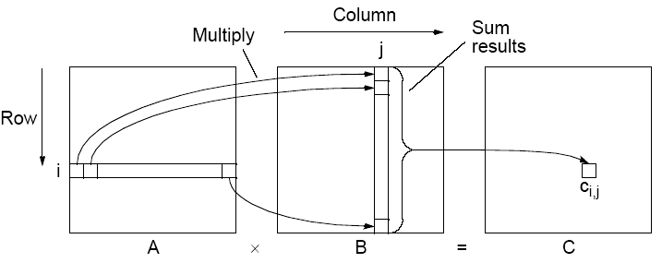

Multiplication of two matrices
C = A_{m x l} X B_{l x m}

Slide 21
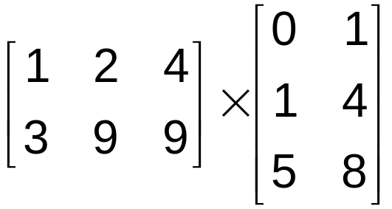
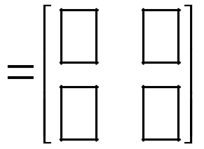

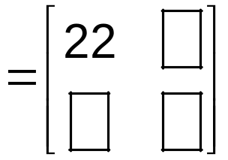

Multiplication of two matrices

Slide 22
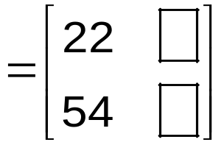

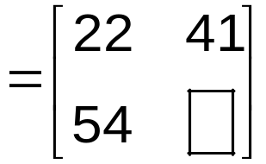

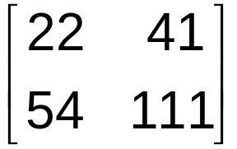
Multiplication of two matrices

Slide 23
Algorithm - Multiplication of two matrices
Algorithm
int a[10][10], b[10][10], c[10][10], i, j, k, m, n, p, q, temp
Read m, n, p, q // size of matrix-a and matrix-b
if n is equal to p // check the constraint of multiplication
  Read matrices a and b
  for i = 1 to m // The rows of the first matrix
    For j = 1 to q // The columns of the second matrix
      c [i][j] = 0
      For k = 1 to p // number of multiplications in each element
        c[i][j] = c[i][j] + a[i][k] * b[k][j]
  Output c
Else Output “multiplication is not possible”

Slide 24
Program - Multiplication of two matrices
#include <iostream>
using namespace std;
int main()
{ int m, n, p, q, i, j, k, a[10][10], b[10][10], c[10][10];
// m and n are the size of the matrices, a and b are the input
// matrices and addition a and b are stored in c
cout << "Enter the number of rows and columns of matrix1 and matrix2";
cin >> m >> n >> p >> q;
if (n == p)
{cout << endl << "Enter the elements of first matrix“;
for ( i = 0 ; i < m ; i++ )
for ( j = 0 ; j < n ; j++ )
cin >> a[i][j];

Slide 25
Program - Multiplication of two matrices
cout << endl << "Enter the elements of second matrix";
for ( i = 0 ; i < p ; i++ )
for ( j = 0 ; j < q ; j++ )
cin >> b[i][j];
//Multiply the two matrices
for ( i = 0 ; i < m ; i++ ) // rows of the first matrix
for ( j = 0 ; j < q ; j++ ) // columns of the second matrix
{
c[i][j] = 0;
// number of multiplications in each element of the resultant matrix
for( k = 0; k < n; k++)
c[i][j] + = a[i][k] * b[k][j];
}

Slide 26
Program - Multiplication of two matrices
cout << endl << “Multiplication of the two matrices are ...“;
cout << endl;
for ( i = 0 ; i < m ; i++ )
{
for ( j = 0 ; j < q ; j++ )
cout << “ “ << c[i][j];
cout << endl;
}
} // if close
else
cout << “Multiplication is not possible”;
return 0;
}

